Slide 1
HTML Tags
Abu Jafar Saifullah
1109

Slide 2
Topics
<q> : The Inline Quotation element
<select> : The HTML Select element
<option> : The HTML Option element

Slide 3
<q>: The Inline Quotation element
The <q> HTML element indicates that the enclosed text is a short inline quotation.
This element is intended for short quotations that don’t require paragraph breaks
For long quotations, <blockquote> is used
This element includes an attribute ‘cite’

Slide 4
Examples
Code
Output

Slide 5
<select> & <Option>
The <select> element represents a control that provides a menu of options
The <option> element is used to define an item contained in a <select>.
Option contains a value that is submitted to the server
Option can be further nested using <optgroup> element
Multiples values can be selected using select

Slide 6
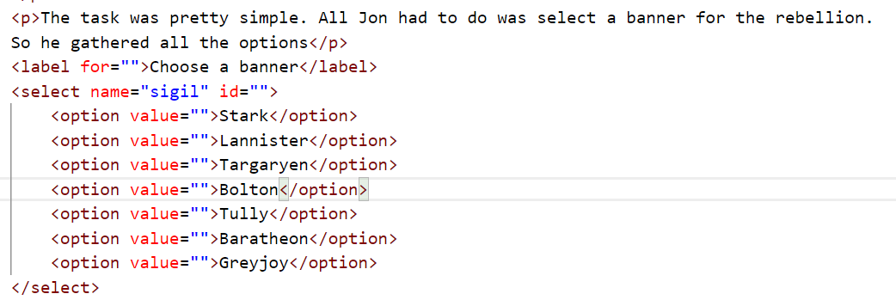
More examples
Code

Slide 7
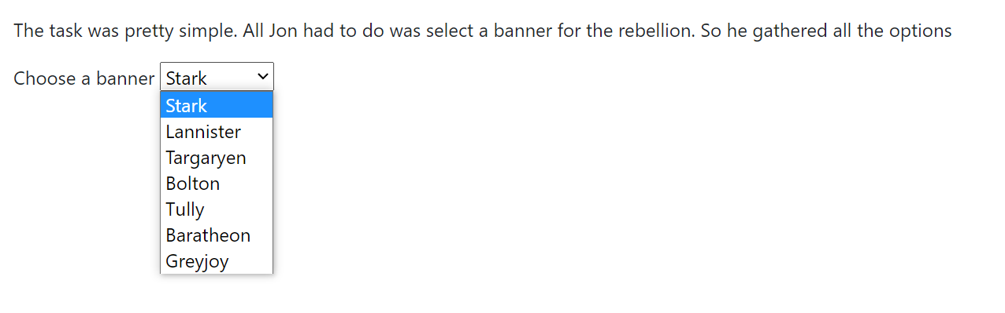
Output

Slide 8
Thank you

